Slide 1

Module 20 Summary: AdaBoost
We learned how boosting builds strong models by learning from mistakes—turning weaknesses into strengths through adaptive focus and sequential improvement.

Slide 2



What Boosting Really Means
Sequential Training
Adaptive Focus
Learning from Errors
Boosting trains models one after another, each learning from the previous round's performance.
Each model concentrates more attention on the difficult samples that previous models struggled with.
Mistakes aren't ignored—they become the foundation for improvement in subsequent iterations.
Boosting does not forget errors. It studies them.

Slide 3

What Makes AdaBoost Special
Core Strengths
Adaptive reweighting: Automatically increases focus on misclassified samples after each round
Simple weak learners: Uses intentionally basic models like decision stumps as building blocks
Weighted voting: Combines predictions through a sophisticated voting system that values accuracy
AdaBoost is simple, not shallow. Its power comes from strategic combination.

Slide 4
Weak Learners Are the Secret
01
02
03
Intentional Simplicity
Decision Stumps
Combination Power
Weak learners are deliberately kept simple—just slightly better than random guessing.
The most common choice: single-level decision trees that make one simple split.
True strength emerges from combining many focused simple models, not from individual complexity.
Truth bomb: One smart model is nice. Many focused simple models are better.

Slide 5
Training and Prediction Takeaway
1
Round-Based Training
Training happens sequentially in discrete rounds, with each round building on previous results.
2
Dynamic Weighting
Sample importance shifts over time—harder examples receive more attention as training progresses.
3
Weighted Vote
Final predictions emerge from a weighted vote where stronger learners have greater influence.
You now understand what happens behind the code. The algorithm's elegance lies in this adaptive, iterative refinement process.

Slide 6
Parameters That Actually Matter
1
2
3
n_estimators
learning_rate
estimator
Controls how many weak learners are trained and combined. More learners generally improve performance but increase training time.
Determines the contribution strength of each learner. Lower values require more estimators but often generalize better.
Specifies the type of weak learner used. Decision stumps are default, but you can customize the base model.
Advice: Tune slowly and deliberately. Bigger is not always better—balance complexity with generalization.

Slide 7
When AdaBoost Works Well
Clean or Moderately Clean Data
AdaBoost thrives when data quality is good and outliers are minimal or manageable.
Binary Classification Problems
Originally designed for two-class problems, where it demonstrates exceptional performance and interpretability.
Error Correction Matters
Ideal when fixing classification mistakes is critical and you want the model to learn from difficult cases.
Strong Performance Without Complexity
Perfect when you need powerful predictions without building overly complex individual models.

Slide 8
When AdaBoost Is a Bad Idea
Avoid AdaBoost When:
Heavy Outliers Present
Noisy Labels
Impossible Samples
Data contains many extreme outliers that don't represent the true pattern.
Target labels are unreliable or contain significant errors and inconsistencies.
A few samples are fundamentally impossible to classify correctly given the features.
Honest line: AdaBoost can obsess over bad data, continuously trying to fit noise instead of signal.

Slide 9

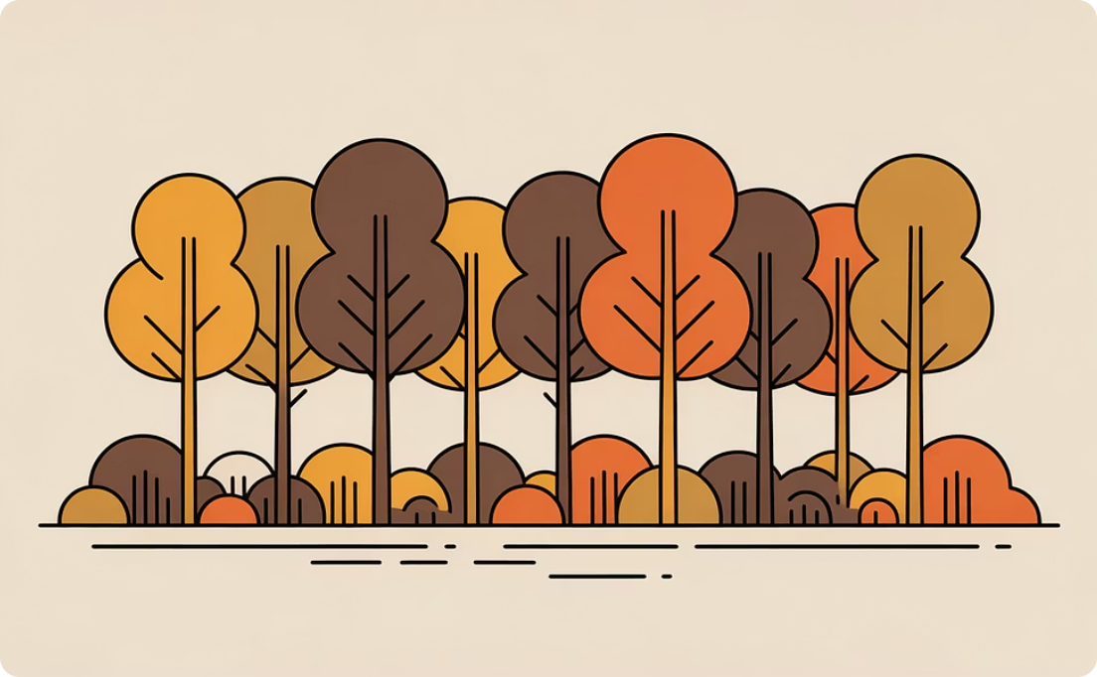

AdaBoost vs What You Already Know
Decision Tree
Random Forest
AdaBoost
Approach: Single model, simple and fast
Approach: Parallel ensemble, trains independently
Approach: Sequential ensemble, adaptive learning
Limitation: High variance, prone to overfitting
Strength: Reduces variance through averaging
Strength: Reduces bias through error focus
Best for: Quick baselines and interpretability
Best for: Stable predictions on noisy data
Best for: Clean data needing high accuracy
Mindset tip: These are different tools for different jobs. Understanding when to apply each is part of becoming a skilled practitioner.

Slide 10
What You Can Do Now
Explain the Concept
Understand the Process
Describe boosting clearly in simple words to technical and non-technical audiences alike.
Walk through how AdaBoost trains step by step, explaining the adaptive weighting mechanism.
Implement in Python
Evaluate Performance
Write and run AdaBoost code using scikit-learn with appropriate parameters and preprocessing.
Assess model quality using proper metrics, cross-validation, and comparison against baselines.
You've built a solid foundation in ensemble learning. These skills transfer to more advanced boosting methods and real-world applications.

